Slide 1
CMPSC 100
Computational Expression

Slide 2
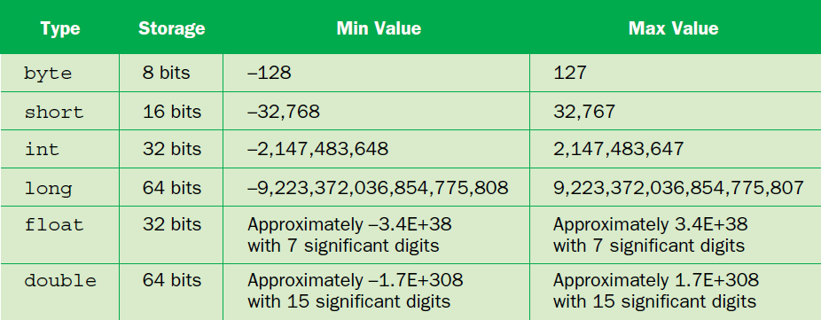
Primitive data types

Slide 3
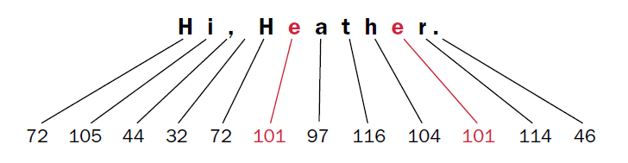
Primitive data type
“String” is missing, though
Why?
Because Strings are essentially made up of “Char” objects (which aren’t primitives either)
And because “Char” objects are pointers to numbers representing elements of a set

Slide 4
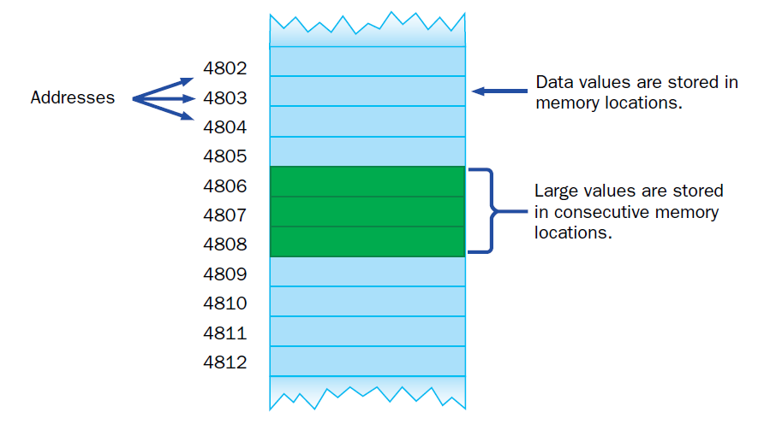
Java as a “strongly-typed” language
Notes:
Create diagram on the board to simulate

Slide 5
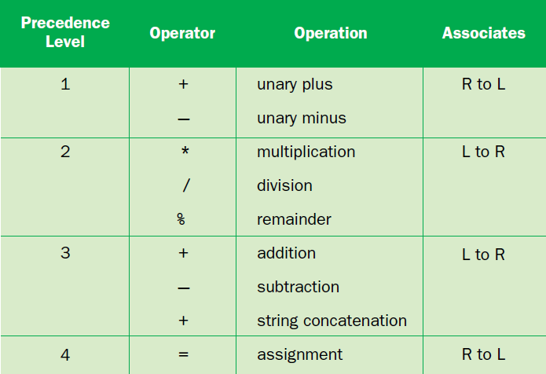
R to L, L to Right “association”
Notes:
Show some operations

Slide 6
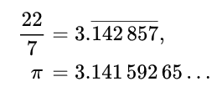




int vs. float vs. double
int pi = 22/7
short pi = 22/7
long pi = 22L/7L
float pi = 22f/7f
double pi = 22/7
3.142857
3.142857142857143
3
3
3
Notes:
You have the jokes

Slide 7
Let’s try a word problem!
Ten thieves stole some jewels from a local shop. They stole a bag of fifty six pearls. Some of them were armed and some were unarmed. The armed ones were those of senior rank. When it came to dividing them up, each senior robber took six pearls, and each junior robber got five. How many of the robbers were senior?
Rephreased from https://www.cut-the-knot.org/Outline/WordProblems/AliBabaRobbery5.shtml#

Slide 8
int seniorMembers = jewels - thieves * minShare;
int juniorMembers = thieves - seniorMembers

Slide 9
package wordproblems;
/** This class solves the Thieves' Story. * * @author Alton Caylor
*/ public class ThievesStory { final static int jewels = 56; final static int thieves = 10; final static int juniorShare = 5; final static int seniorShare = 6; /** This is the entry point. * * @param The command line arguments. */ public static void main(String[] args) {
int seniorMembers = (juniorShare*thieves-jewels)/(juniorShare-seniorShare); int juniorMembers = (seniorShare*thieves-jewels)/(seniorShare-juniorShare); System.out.print("There are " + juniorMembers + " junior members, " + "and " + seniorMembers + " senior members."); } }

